Slide 1

Global Causes of Death Longitudinal Analysis
Group 1 Members: Josie, Anuja, Jared, Rikin
Notes:
Rikin

Slide 2


About the Dataset
Our dataset shows:
31 diseases (causes of death)
204 countries and territories across the world
30 years (1990-2019)
Data collected/curated from
Our World in Data
Institute for Health Metrics and Evaluation (IHME) – Burden of Disease study
Notes:
Rikin

Slide 3
Worldwide Analysis
How does the cause of death change between 1990-2015?
Notes:
Rikin

Slide 4
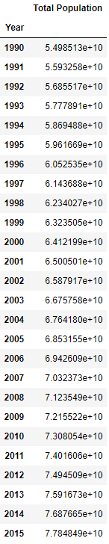
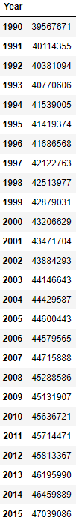
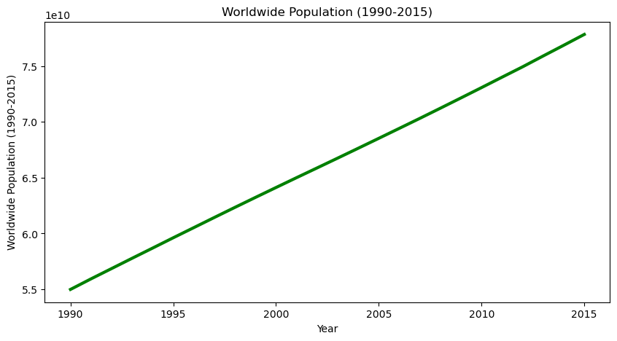
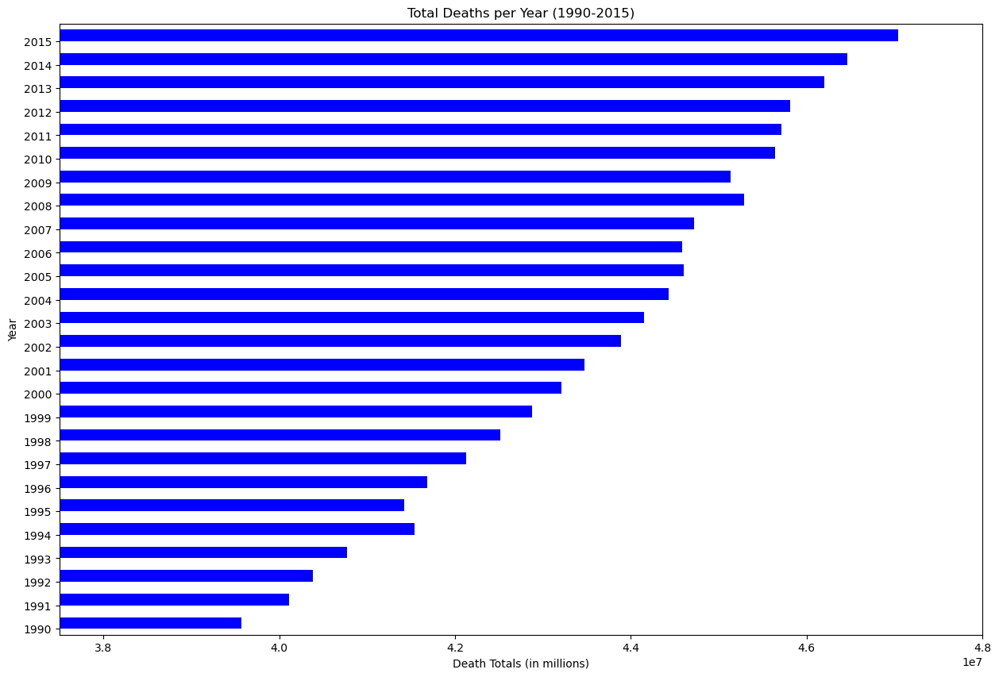
World Population vs Total Deaths per Year (1990-2015)
Total Deaths
Total Deaths
Notes:
Rikin

Slide 5
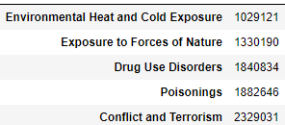
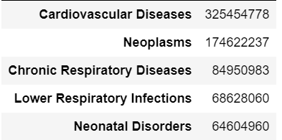
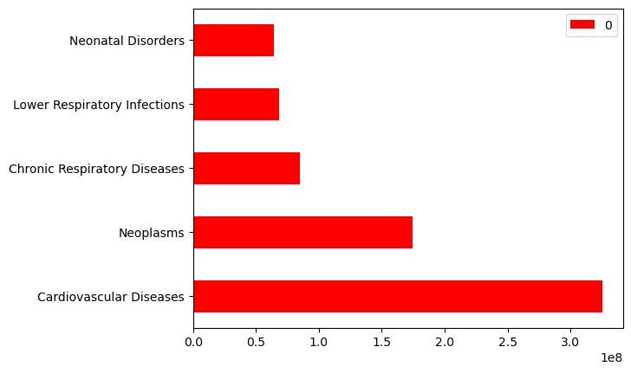
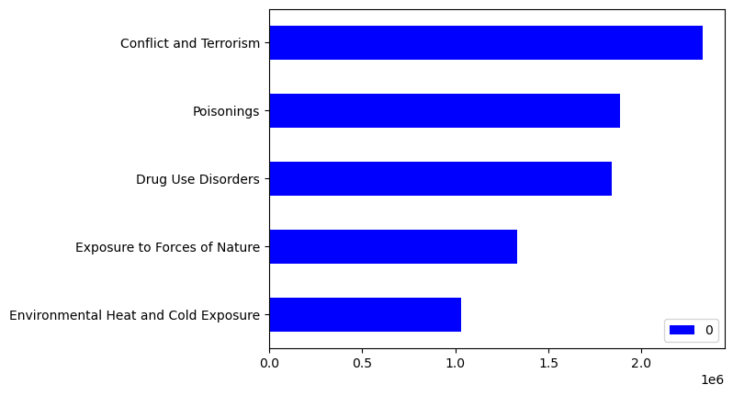
Bottom 5 Diseases
Top 5 Diseases
Notes:
Rikin

Slide 6
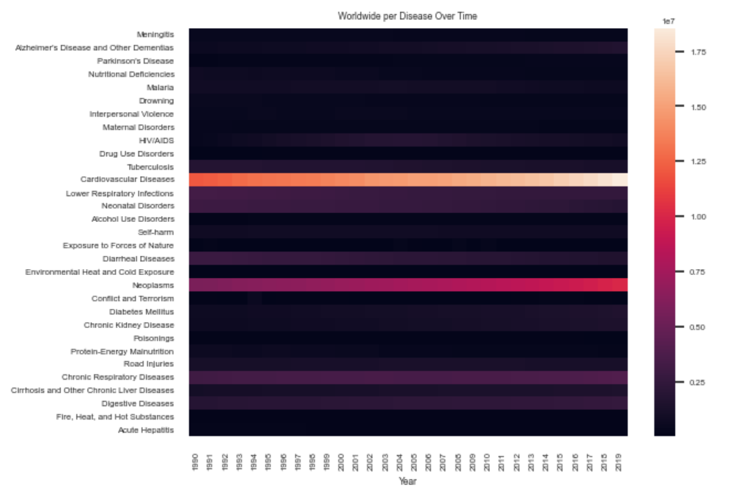
High-Level Overview of Data trends
Notes:
Rikin

Slide 7
Closer Look at Diseases
Communicable, Non-communicable & Injury related deaths
Notes:
Jared
Thank you Rikin. In these next slides, we will look into the raw values of causes of death by three different categories: Communicable, Non-Communicable and Injuries..

Slide 8
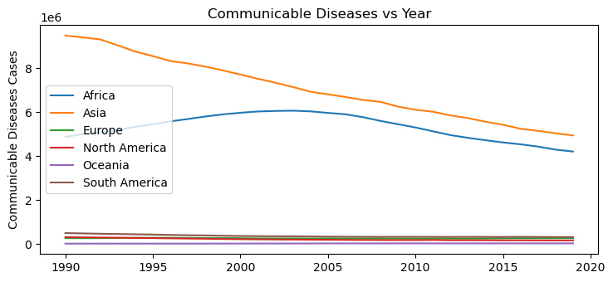
Communicable Diseases
Make sure to sort by population percentage not just raw values :
Eg
Notes:
Jared
In this illustration, Asia has nearly 4 times the population of Africa, however Africa’s raw total of causes of death by Communicable diseases nearly exceeds that of Asia. Diseases such as HIV/AIDS, neonatal and maternal disorders have disproportionately affected the continent of Africa while other continents have a slight negative trend. Although there is an overall negative trendline, this visual aid can show the necessity of healthcare in vulnerable populations such as Africa.
'Lower Respiratory Infection 'Neonatal Disorders', 'Maternal Disorders', 'Malaria 'Nutritional Deficiencies', 'HIV/AIDS','Tuberculosis',
'Meningitis','Protein-Energy Malnutrition','Acute Hepatitis

Slide 9
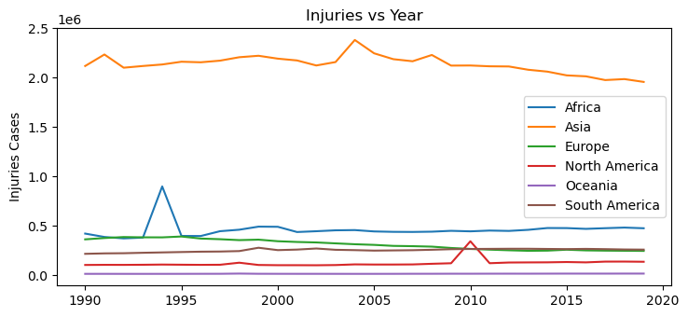
Injuries
Notes:
Jared
As we can see, this visual shows three separate world events that caused large increases in death. First, in 1994, on the blue line, representing the continent of Africa, the data illustrates the Rwandan Genocide with a death toll of nearly a million people. Secondly, in 2004, on the orange line representing the continent of Asia, we see a 9.1 magnitude earthquake near Sumatra, Indonesia that created a gigantic tsunami which caused a catastrophic event along the entire Indian Ocean region. Last, for the continent of North America, the data illustrates the sharp rise in 2010 due to the Haitian Earthquakes.
'Lower Respiratory Infections',
'Neonatal Disorders',
'Maternal Disorders',
'Malaria',
'Nutritional Deficiencies',
'Tuberculosis',
'Meningitis','Protein-Energy Malnutrition','Acute Hepatitis

Slide 10
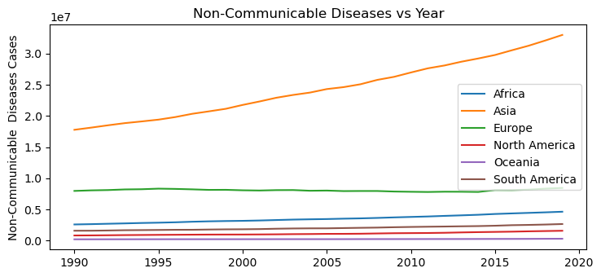
Non-Communicable Diseases
Notes:
Jared
Diseases such as neoplasms and cardiovascular disease have been steadily increasing amongst all populations of the world. In this visualization, the data shows a positive tendency that all continents have increasing death rates from these non-communicable diseases.
'Chronic Respiratory Diseases',
'Diabetes Mellitus',
'Drug Use Disorders',
'Alcohol Use Disorders',
'Cirrhosis and Other Chronic Liver Diseases',
'Digestive Diseases',
'Alzheimers Disease Dementias',
'Parkinsons Disease','Chronic Kidney Disease']
Despite these graphs showing raw values, we see a different story when the percentage of a continent’s population is taken into account. My teammate, Anuja Panthari, will dive deeper in this important difference.

Slide 11
What is the Leading Cause of Death Worldwide ?
Notes:
Anuja
Deeper dive into the specific diseases that were causing the most number of deaths by continent throughout the years

Slide 12
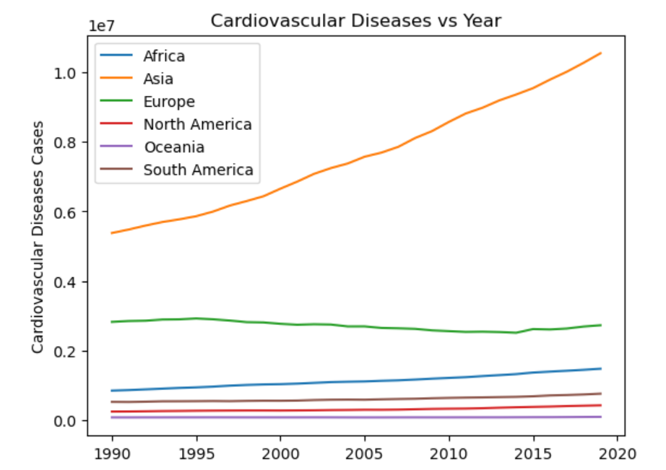
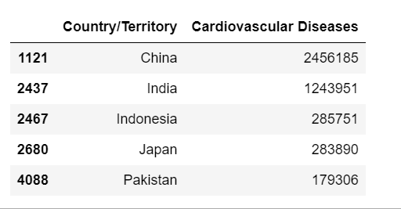
Cardiovascular disease (CVD) is the leading cause of death
Top 5 Asian countries w/ the highest numbers of CVD deaths:
Notes:
Anuja
-CVD leading cause of death regardless of continents and year
-when we plot CVD by continent, we see that asia by far has the highest number of CVD cases
-when we looked into which countries within asia that caused those high number, we see that the most populated countries within asia had most of those number (china, india)
- Because we know that asia accounts for 60 percent of the world population, this led us to want to adjust for population of each continent

Slide 13
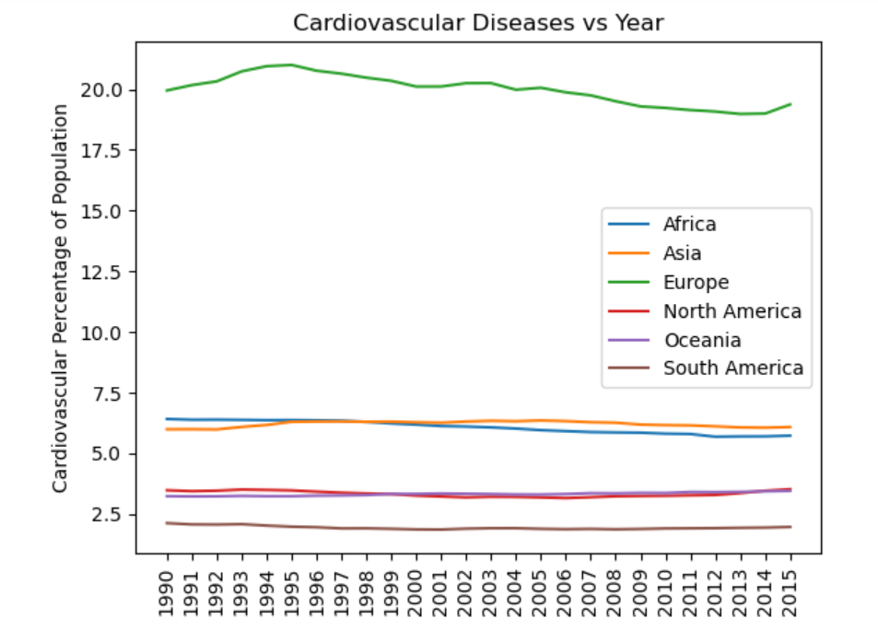
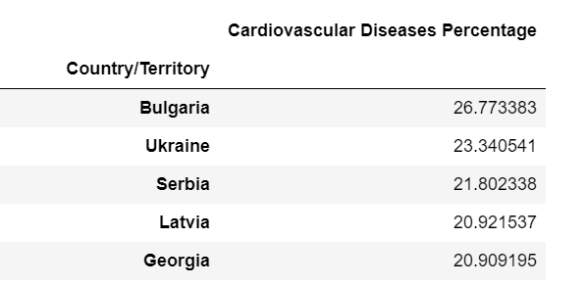
Adjusting for Population
Europeans countries with highest rate across 30 years:
Notes:
Anuja
After adjusting for population of each continent, we see that asia is no longer the leading continent, but europe is.
In other words, 20% of the deaths in Europe are caused by CVD. Whereas the rest of the world has a 2.5%-7% CVD death percentage.
Since CVD is something that affects those over 65 more often this actually indicates that europe is quite healthy because a large number of the population is dying later in life compared to other continents.

Slide 14
In-depth Africa Analysis
What are the top causes of deaths in African countries?
Notes:
Josie

Slide 15
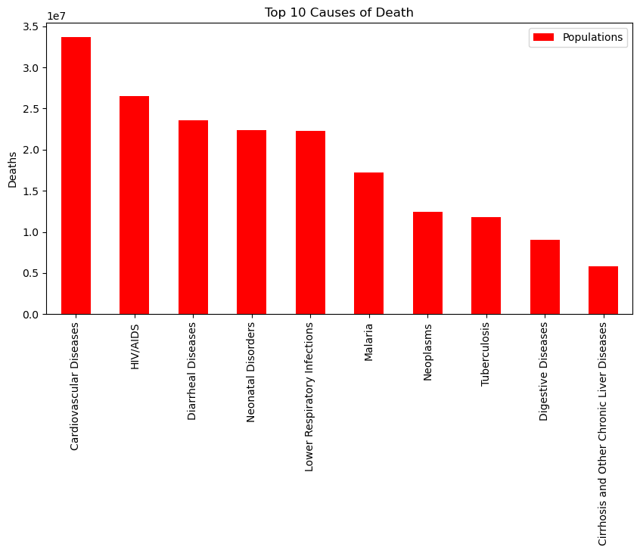
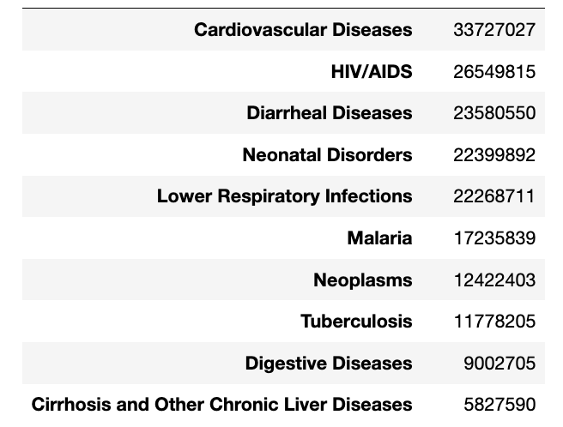
Top 10 reasons of death in African Countries
Notes:
Josie

Slide 16
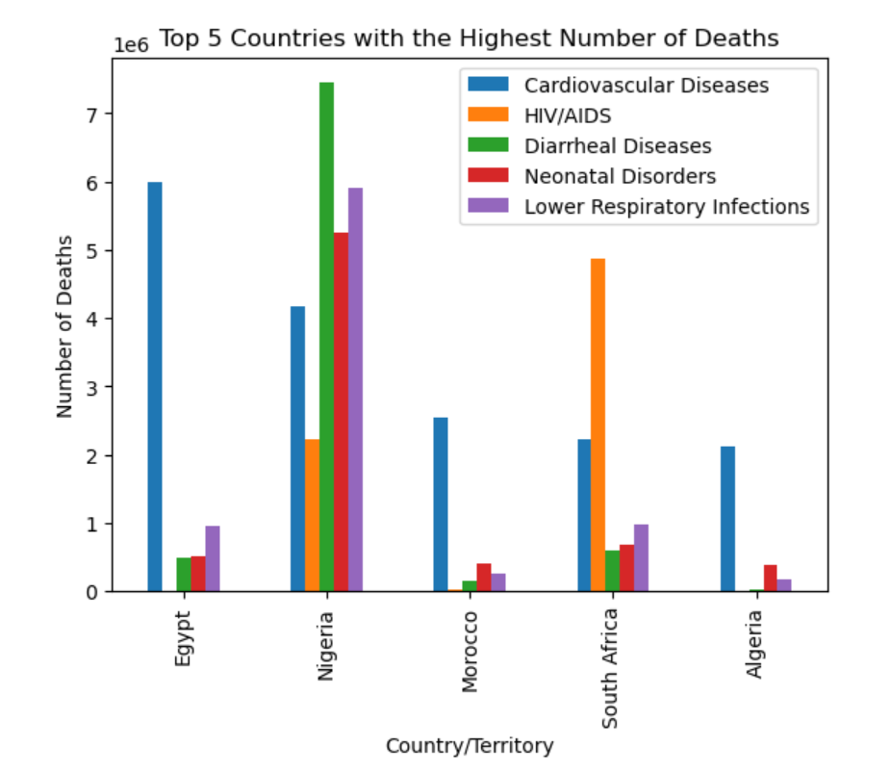
Countries with Highest Number of Deaths
Notes:
Josie

Slide 17
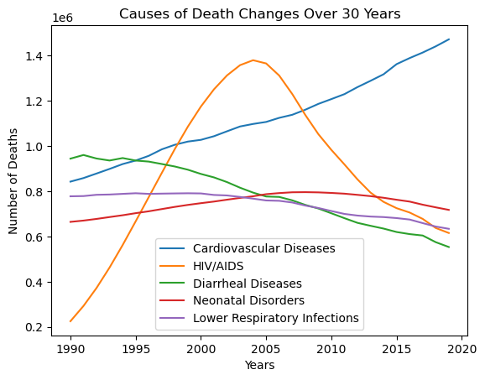
Causes of Death Changes over 30 Years
Notes:
Josie

Slide 18
Key Takeaways
Worldwide: CVD and Neoplasms are the leading cause of death across all years and places
Continent wide: Across all the 3 categories of diseases, Asia had the highest number of cases between all continents.
Disease wide: After adjusting for continent population, we find that CVD has the highest percentage of deaths in Europe
Africa wide: South Africa accounted for almost all the HIV/AIDS cases in Africa during the early 2000s
Notes:
Anuja
The importance of doing this sort of analysis is so that we can know where to allocate resources for certain at risk or vulnerable populations more than others.

Slide 19
Closing Thoughts
Struggles:
Differing sources of data
The data set allowed many drawable conclusions
The raw cause of death rates can skew conclusions/ differ from population percentage death rates
Expansions:
How does age play into cause of death?
Can machine learning predict future trends of diseases?
Why is the world population death rate so linear?
Notes:
Jared

